Slide 1
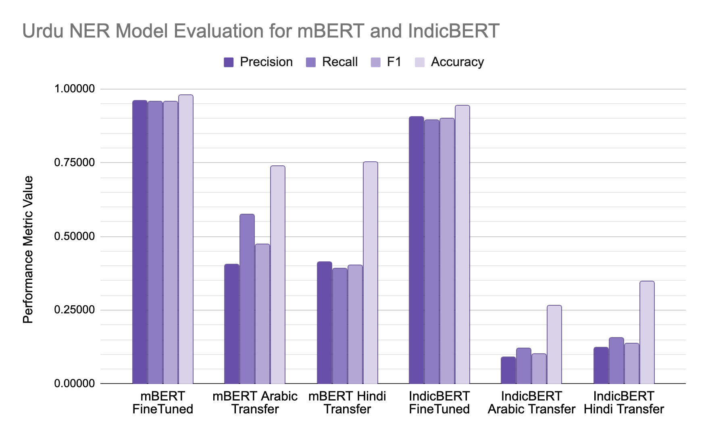
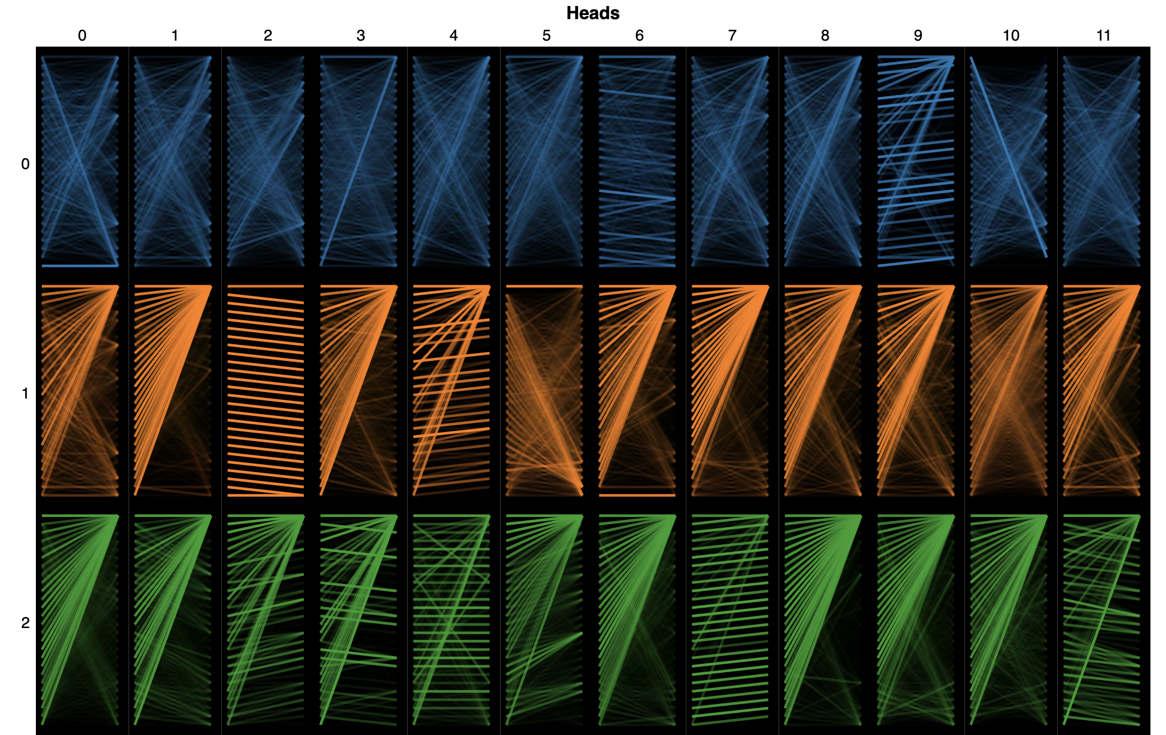
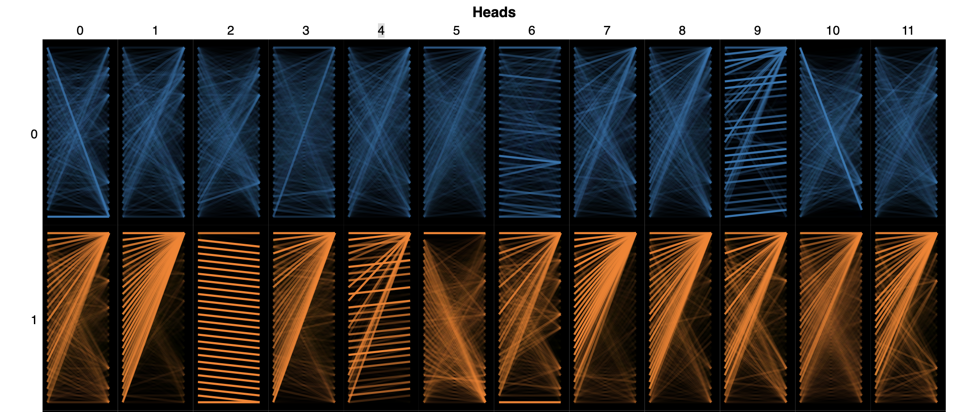
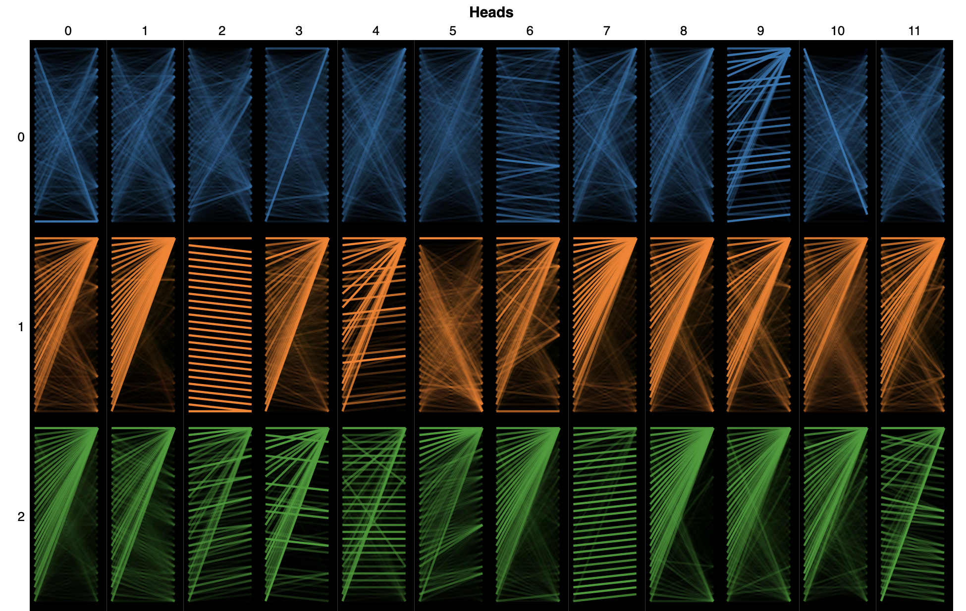
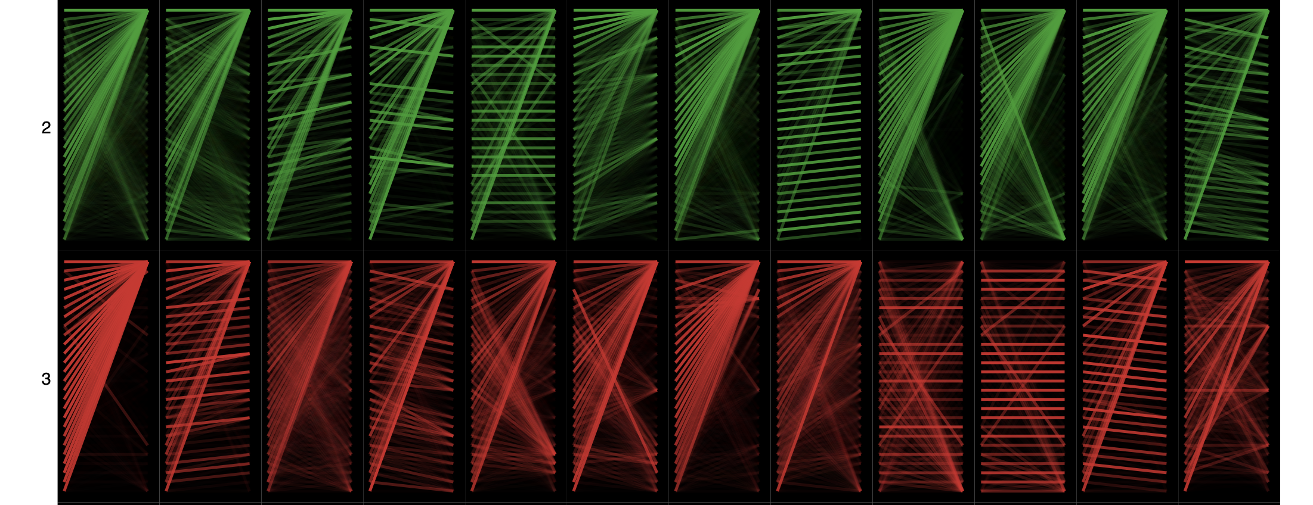
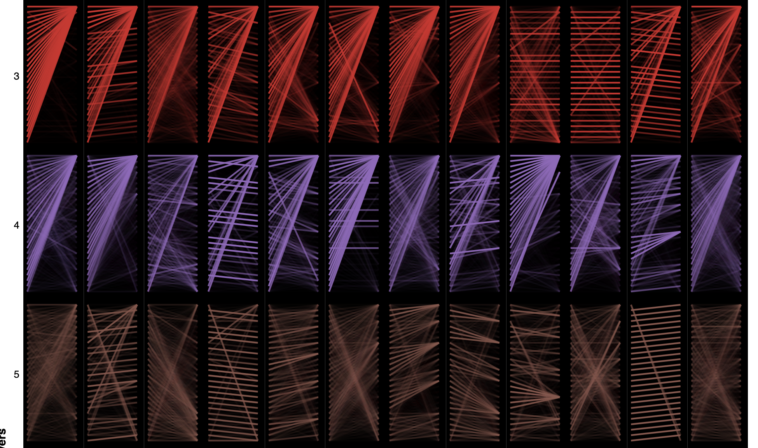
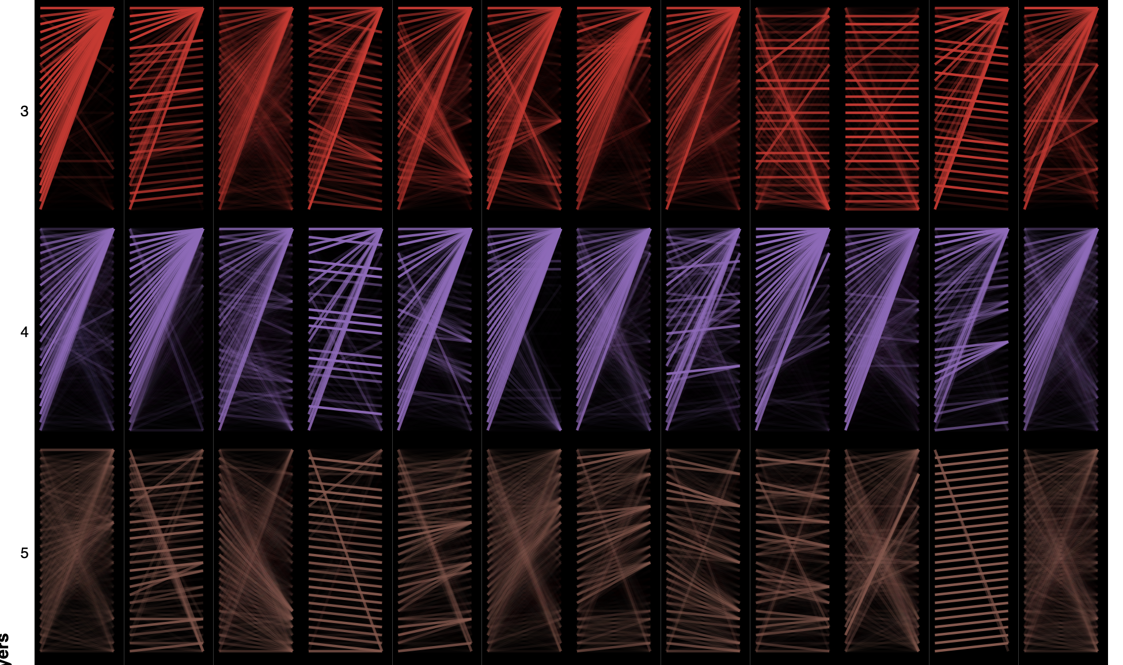
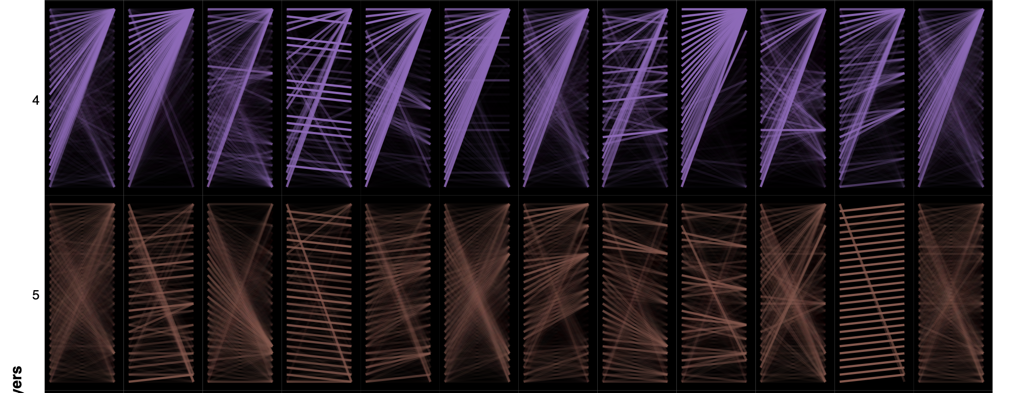
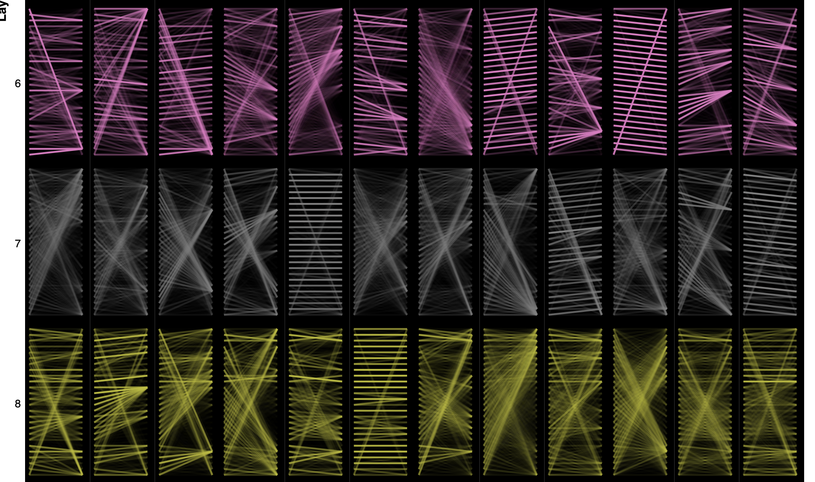
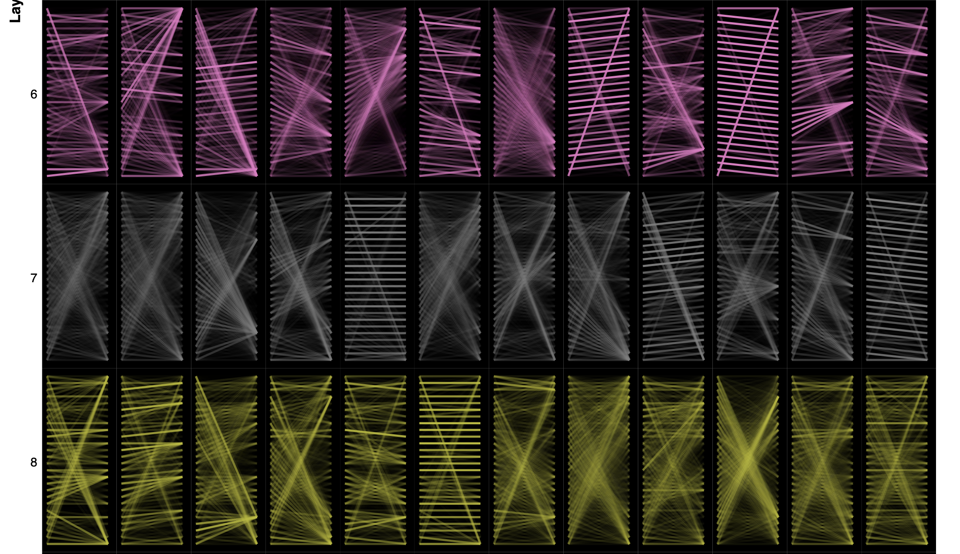
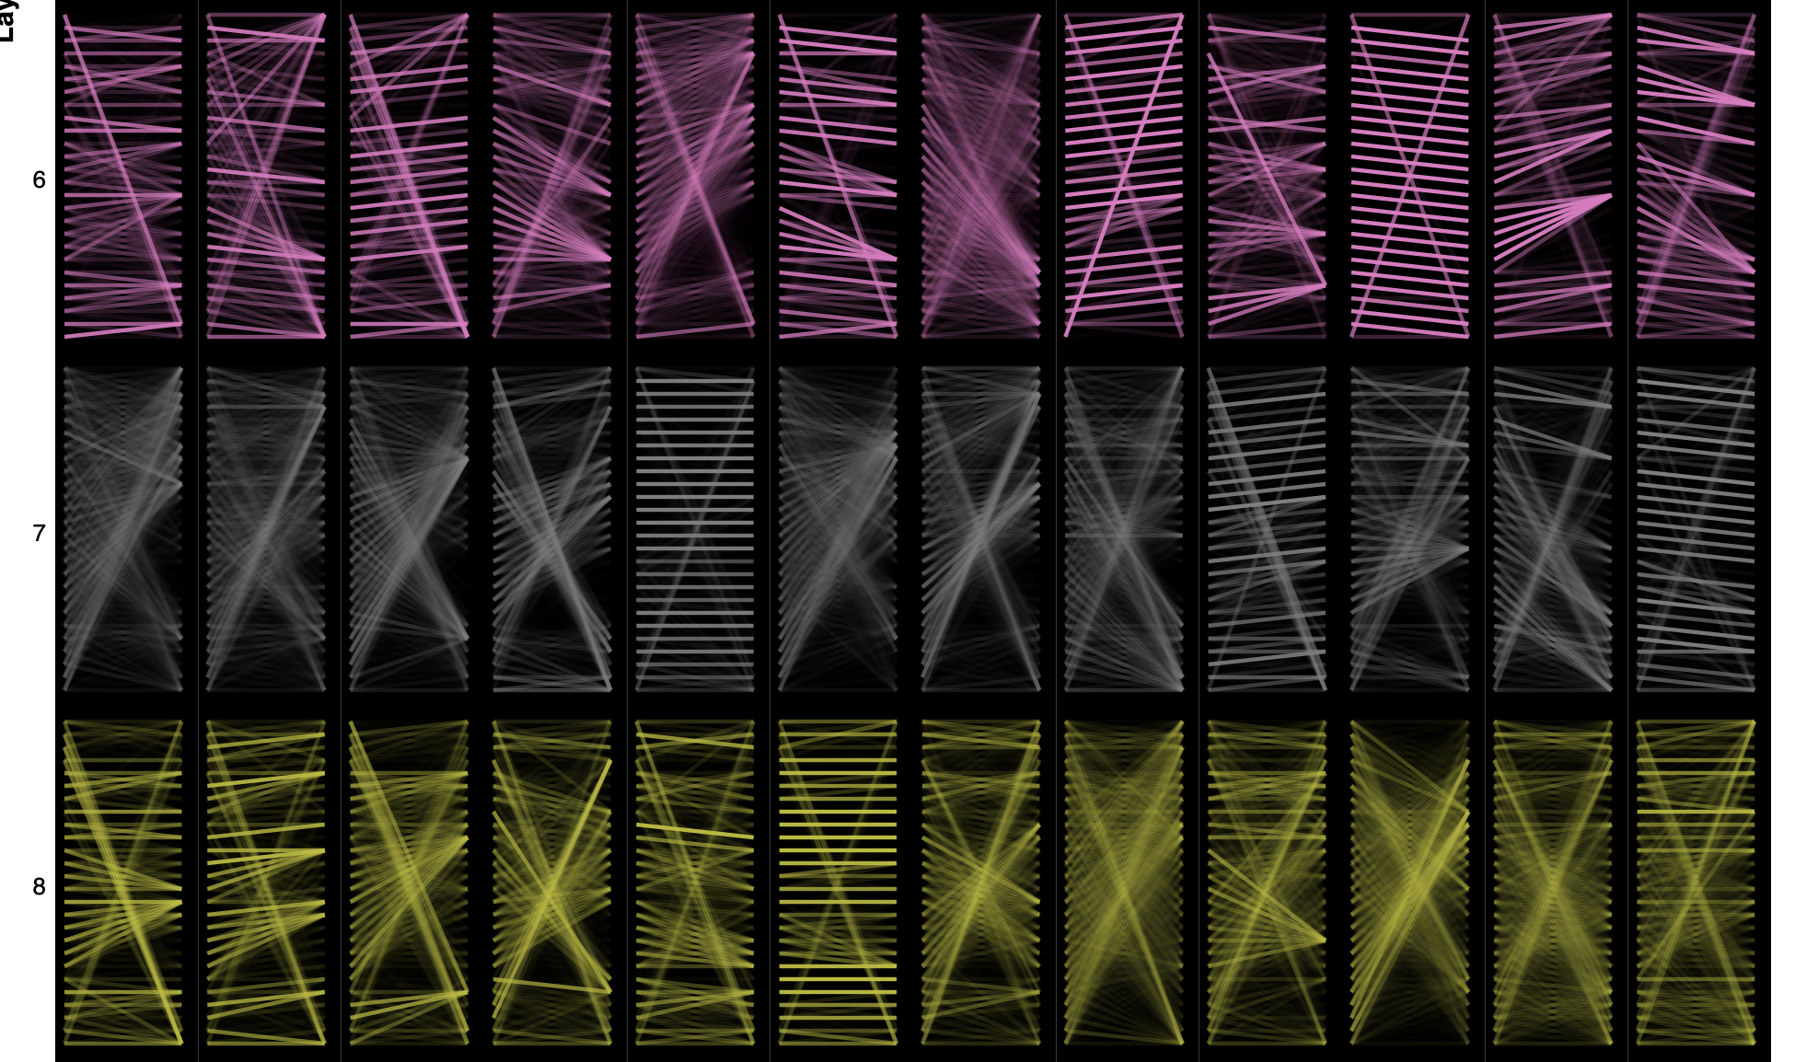
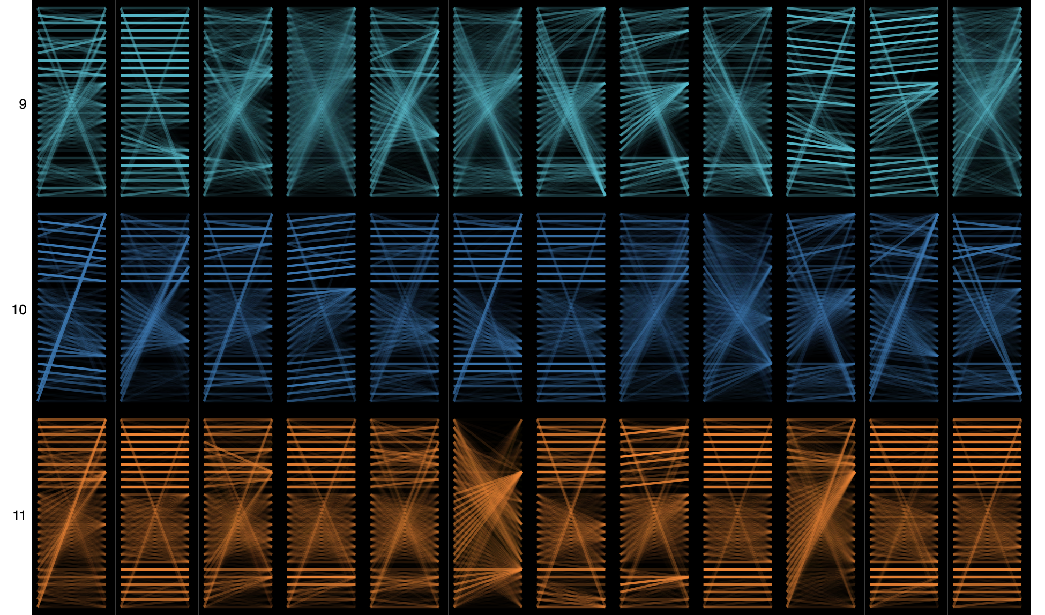
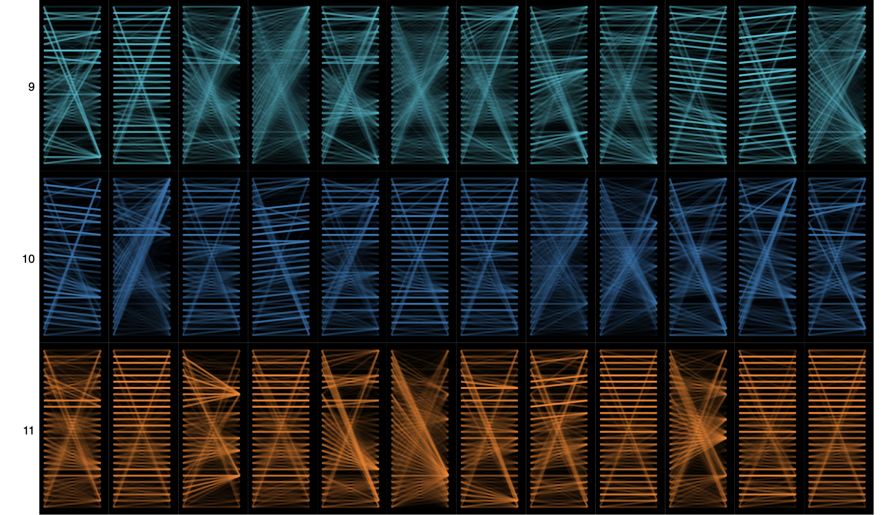
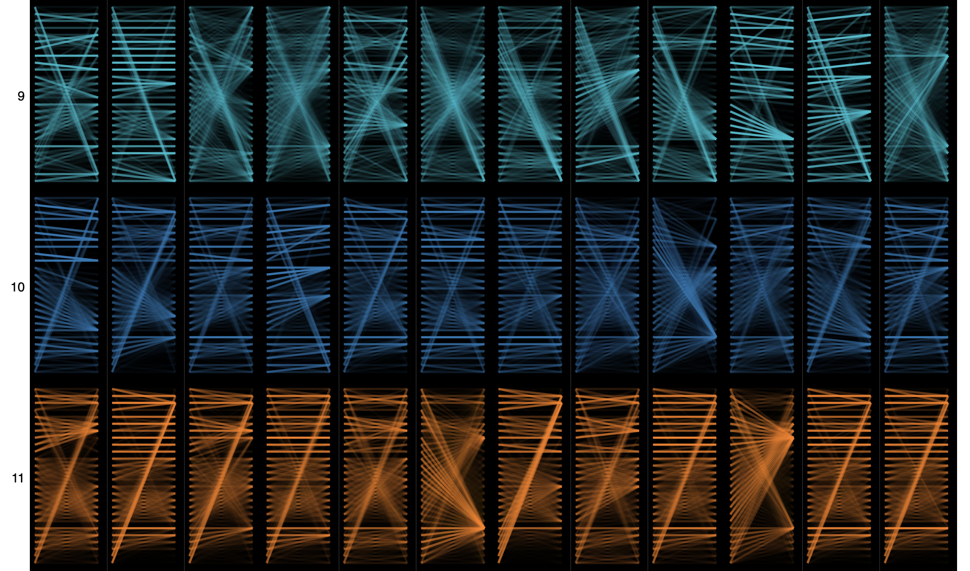
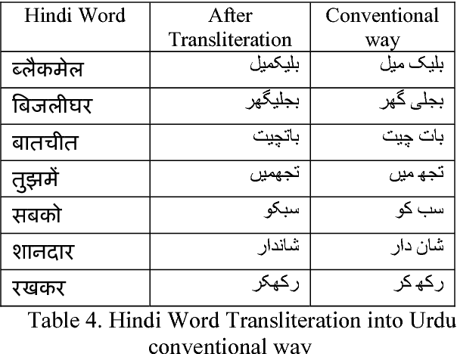
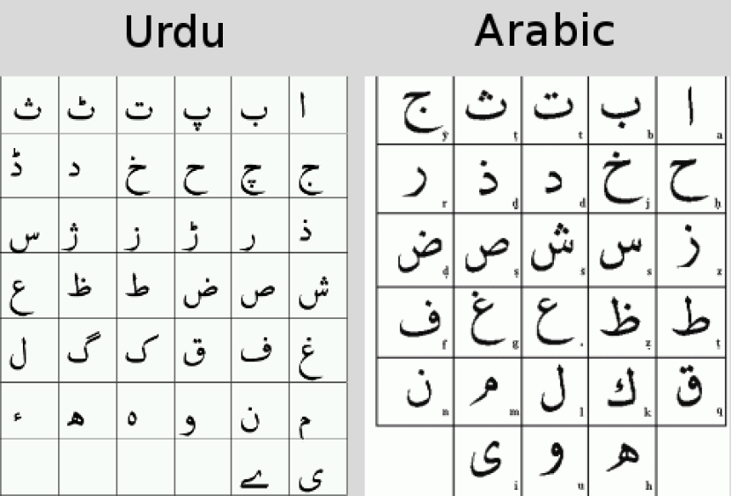
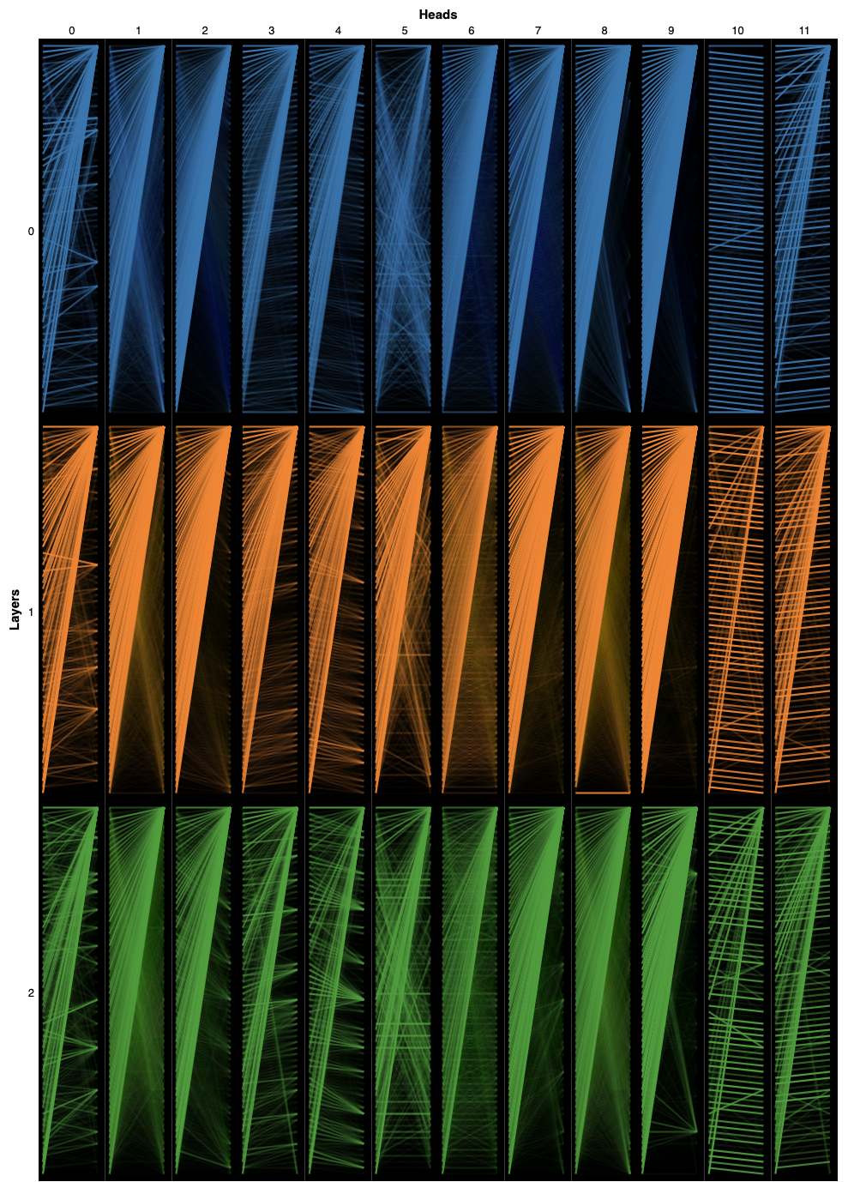
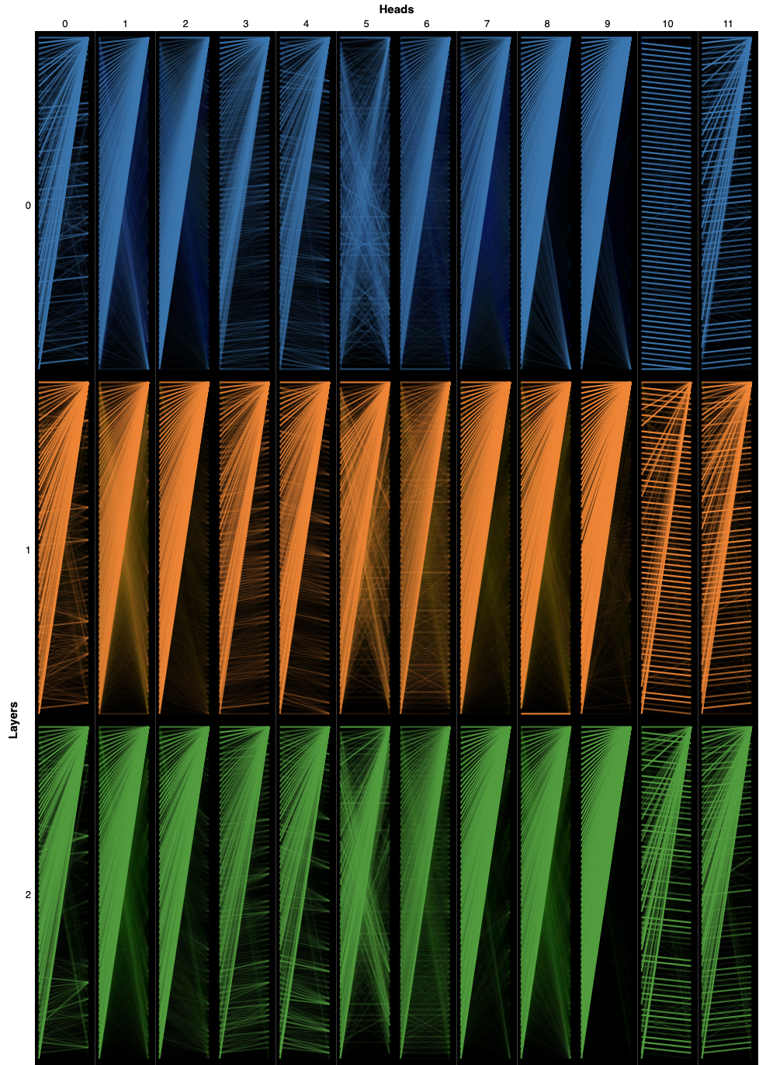
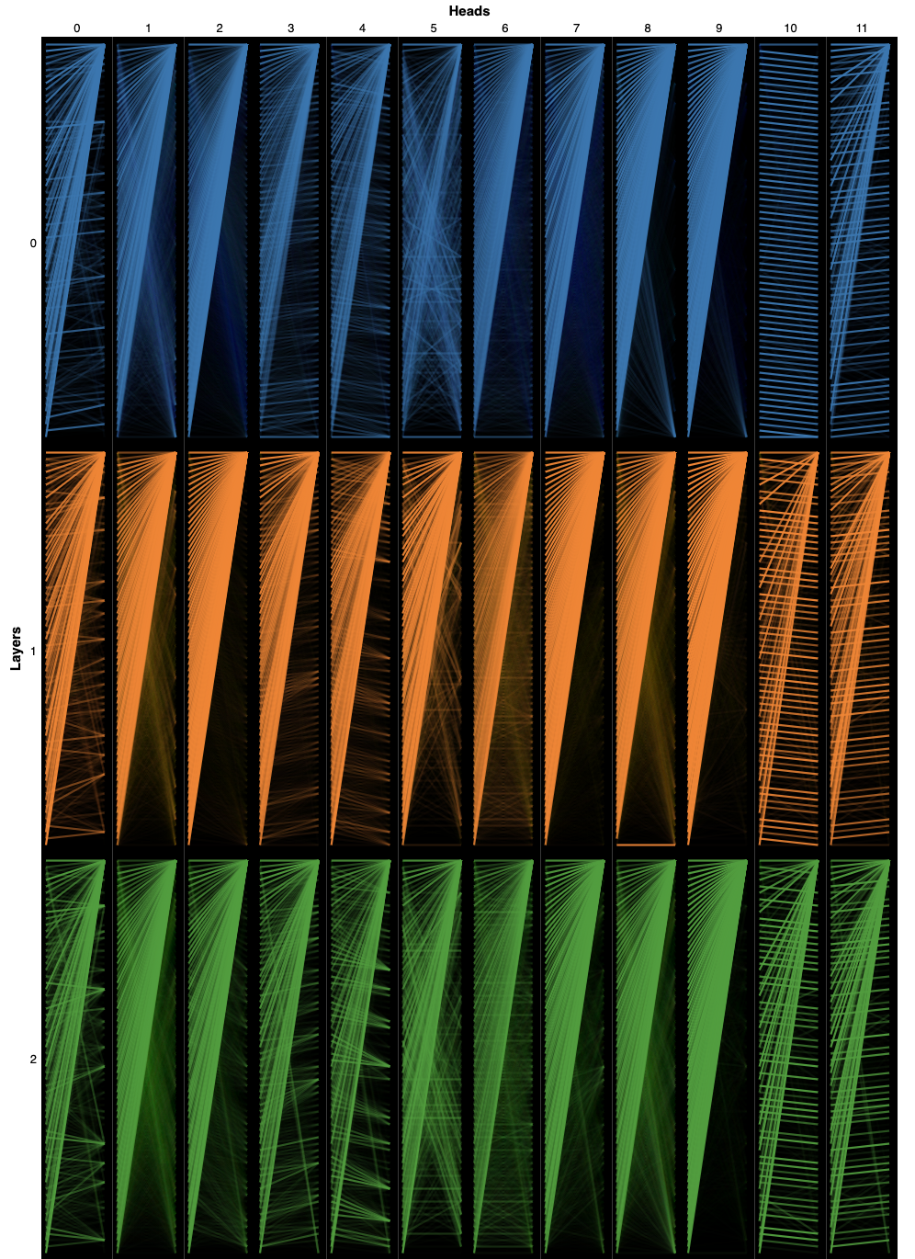
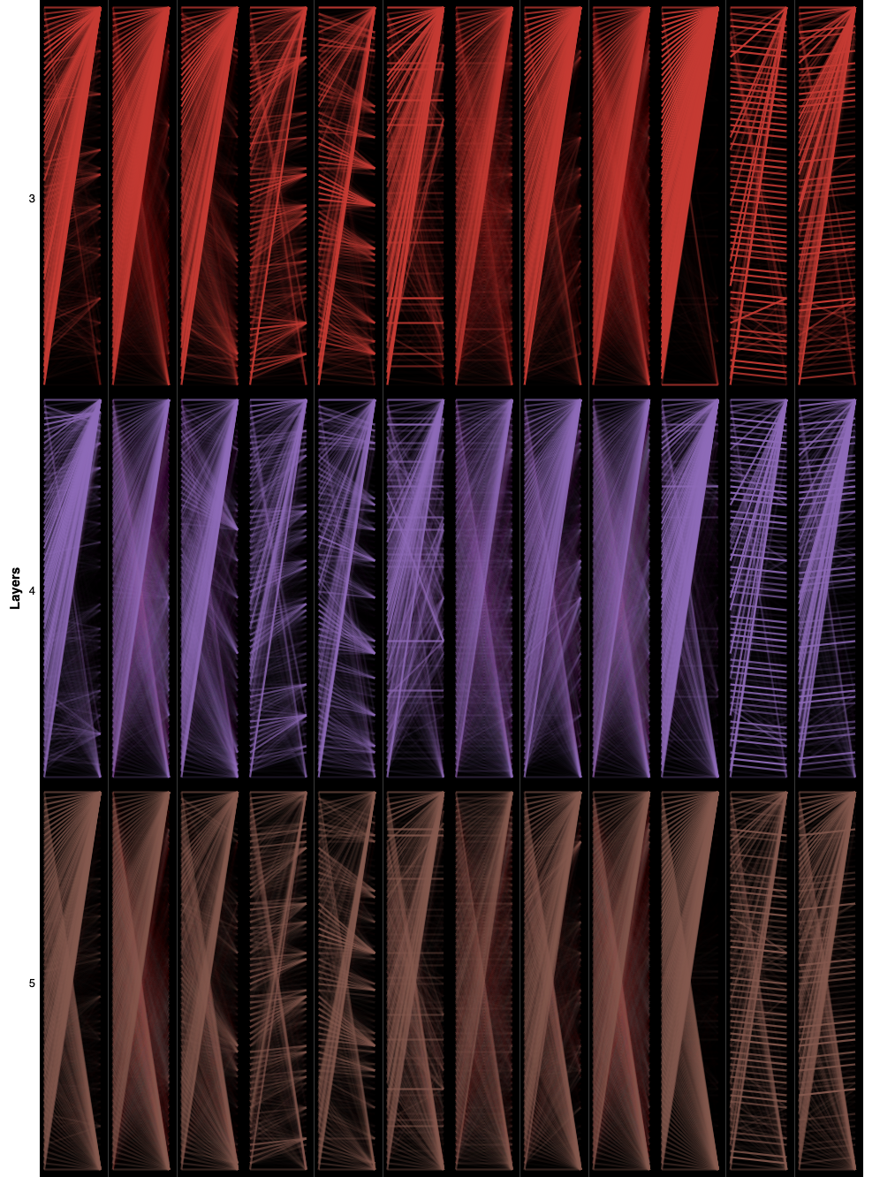
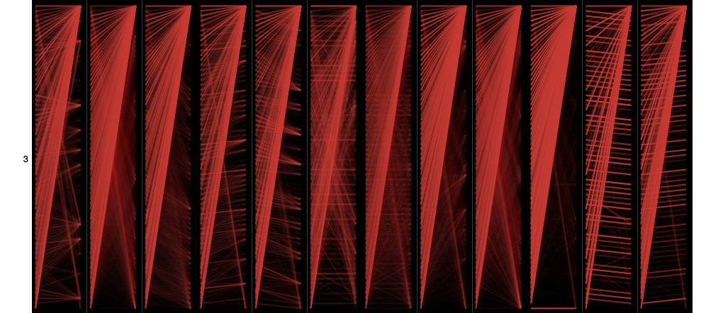
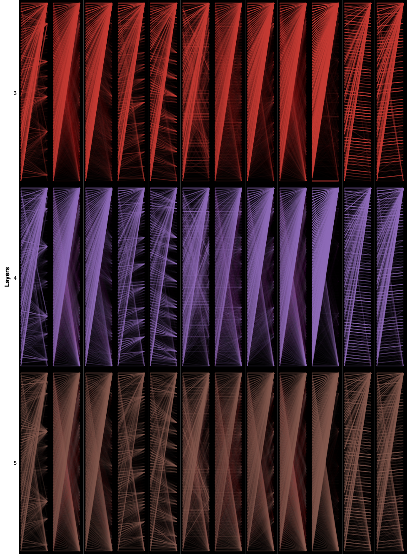
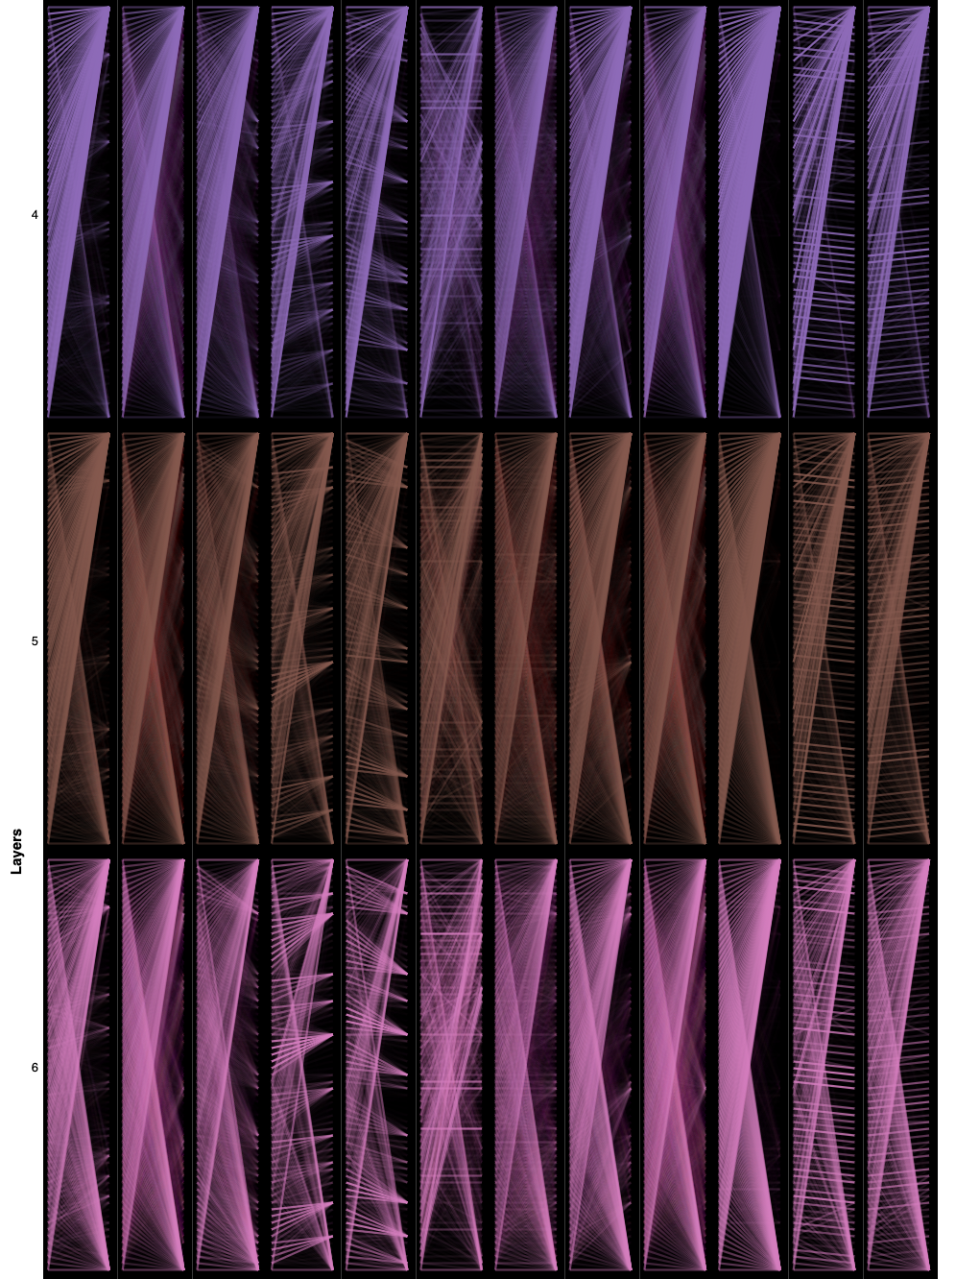
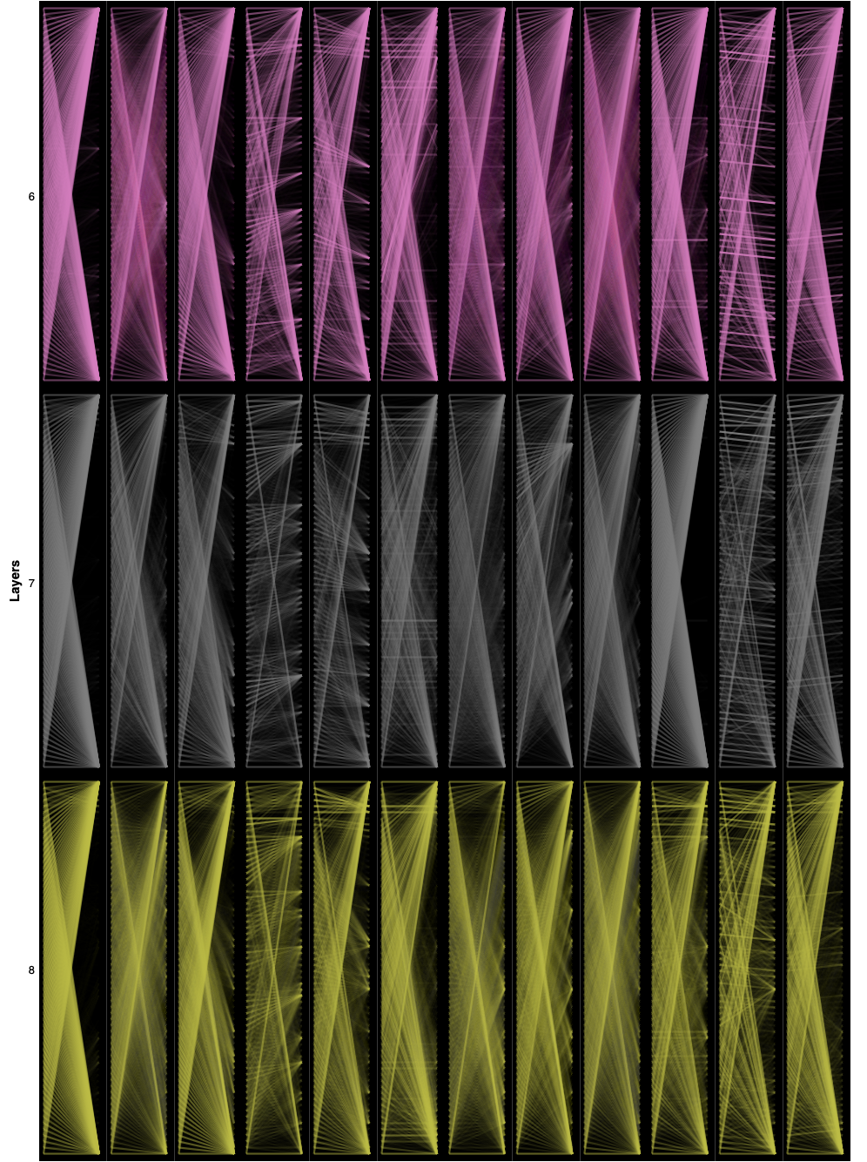
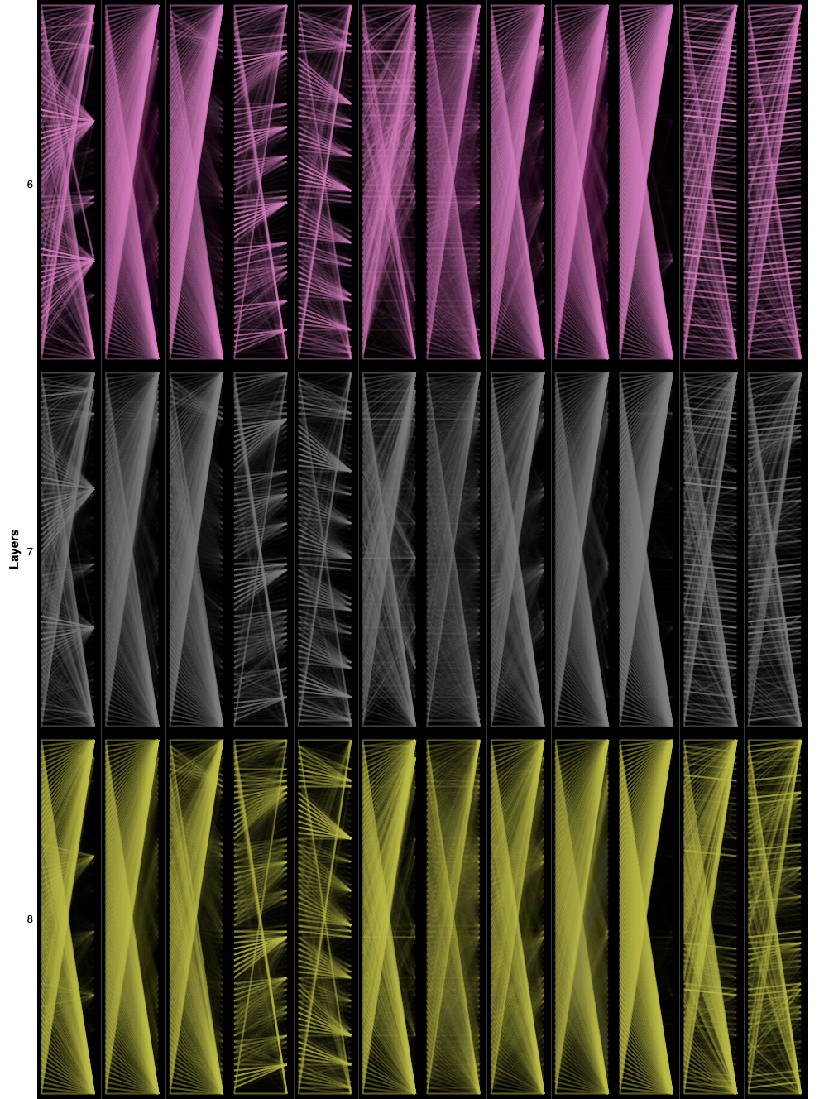
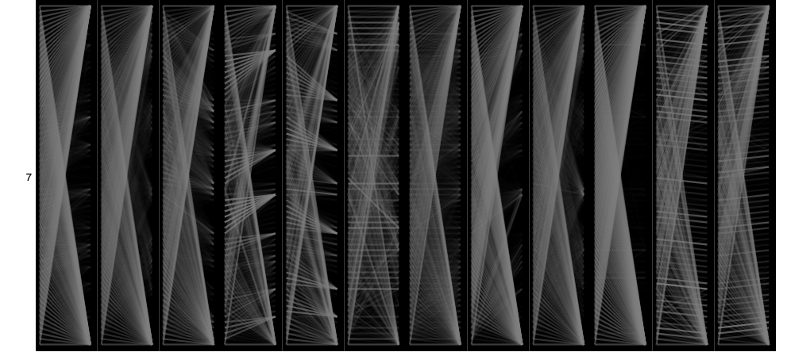
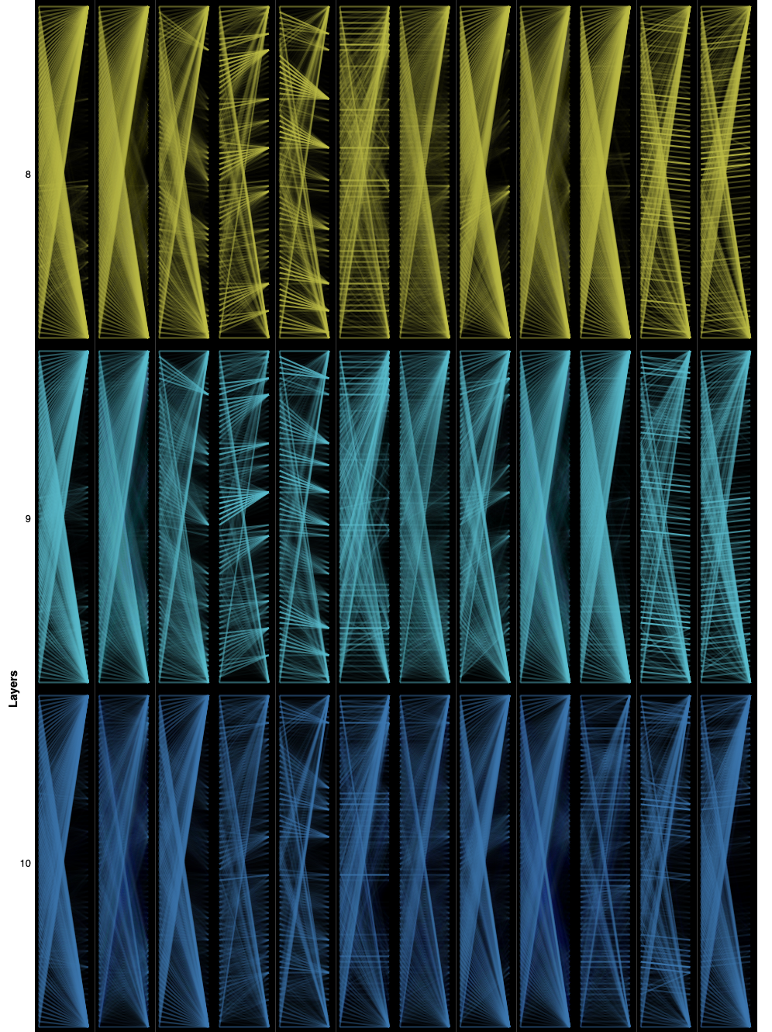
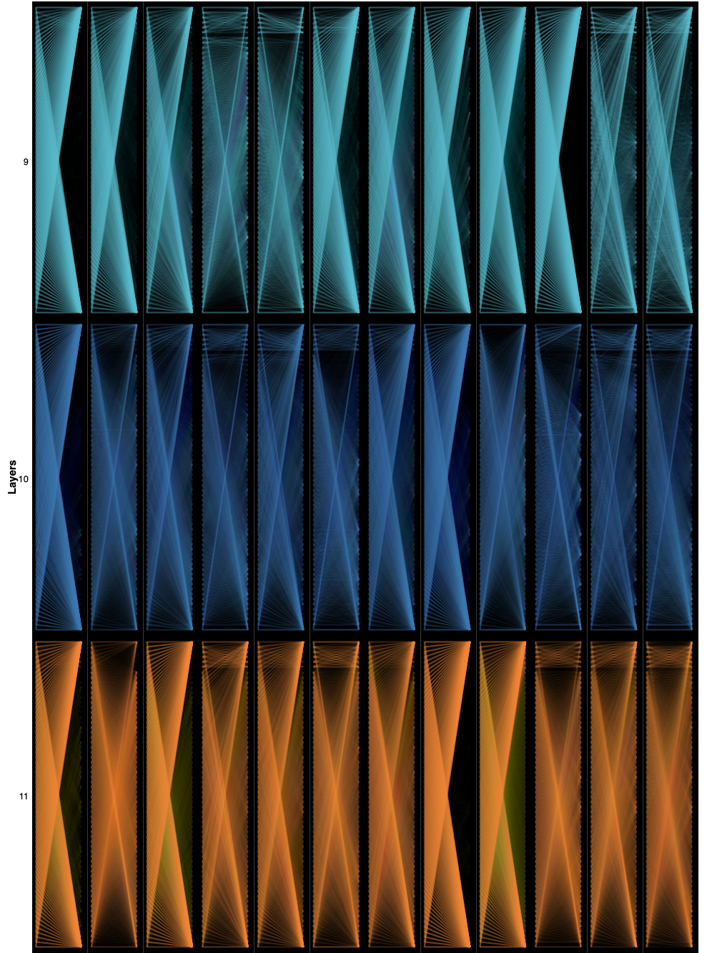
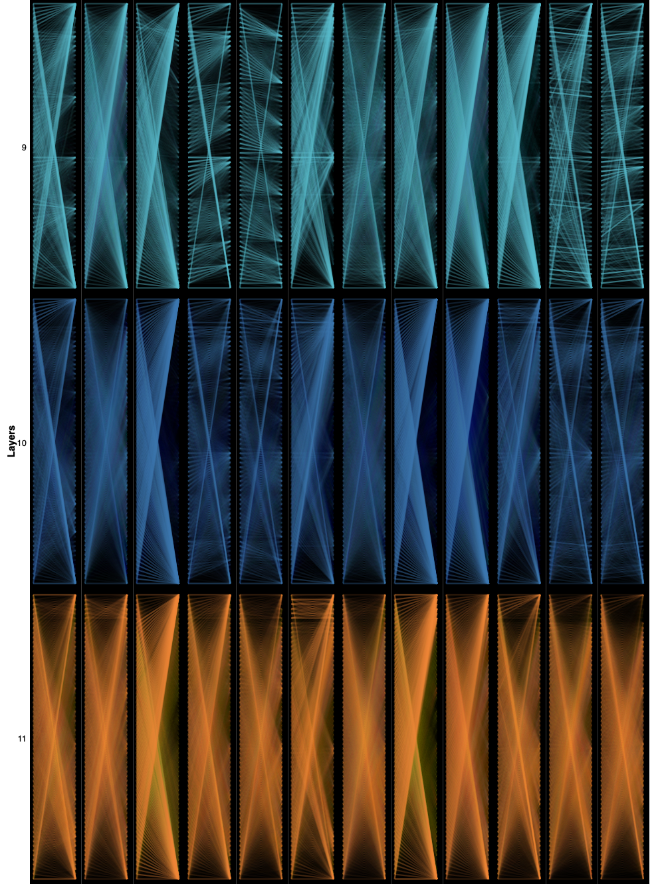
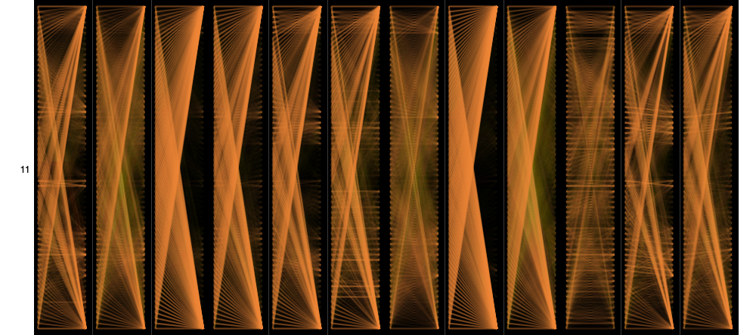
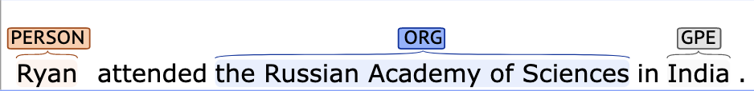
Limited Attention: Investigating Transformer Models’ Zero-Shot Cross-Lingual Transfer Learning with Urdu Named Entity Recognition
Anwesha Mukherjee
Low Resource Language Challenge: Many languages lack tagged or processable data to train or even fine-tune models for specific tasks.
Linguistic Transfer Question:
Can we fine-tune a model for a task in a similar language to work for a low resource language? Idea:
Fine-tune multilingual models using few-shot learning:
Training data from a high-resource related language
Validation and testing data in the target language
Compare performance to models finetuned with target language training data.
Why Urdu to Model the Problem?
Morphological richness with ambiguous language composition
No capitalization
Script (typological) vs. Vocabulary (morphological) Question
Indic language and massive shared vocabulary with Hindi
Arabic/Farsi derived Script
mBERT: Multilingual BERT
SoTA language model pretrained on monolingual corpora of 104 languages
Suitable for typological transfer and morphological transfer
IndicBERT: Indic Language multilingual ALBERT
12 languages (11 Indic and Indian English)
Modified hyperparameters with smaller model
Data: WikiANN Named Entity Recognition Urdu Data
used in IndicGLUE evaluation of both models
3 tags:
Person
Organization
Location
Overview
Attention Analysis for Transformer Models
Comparative Model Performance
mBERT Urdu
mBERT Hindi → Urdu
mBERT Arabic → Urdu
IndicBERT – no Arabic Alphabet
Morphological Similarities – Higher Accuracy
Typological Similarities – Higher f1
Direct Fine-Tuning Converges within 7 epochs
Transfer Fine-Tuning Does not Approach
IndicBERT Urdu
IndicBERT Hindi → Urdu
IndicBERT Arabic → Urdu
Potential Causes: Architectural Differences
Difference | mBERT | IndicBERT
Dropout | 0.1 | 0 | 0 dropout caters to sequence classification and overfits to training language
Model Size | BERT | ALBERT | ALBERT has 9x fewer parameters and 6x fewer embedding layers
Embeddings | 104 langs | 12 langs | IndicBERT has no unit embeddings for the Arabic Alphabet
Tokenizer | WordPiece | SentencePiece | WordPiece: maximize the likelihood of the training data. SentencePiece: pair frequency. Wordpiece had higher rate of merges.
Background
Insights on Cross-Lingual Transfer NER
Token Classification – relies on mix of context and character embeddings
Attention – final layers dictate sequential units
Typological similarities dominate efficacy
Blocks Frozen – Model performs better finetuning all layers rather than just the classifier.
Early Stopping – In transfer learning, the gradient fluctuates largely so early stopping ends training prior to the model’s optimal performance.
Pretrained Roberta – UrBERTo from scratch (without compute limitations)
Mixed few-shot transfer learning (typological + morphological)
mBERT has better distributive attention
Final 2 layers are instrumental to performance dropoff
Intermediate attention loses spread with transfer learning
Notable References
Next Steps
Divyanshu Kakwani, Anoop Kunchukuttan, Satish Golla, Gokul N.C., Avik Bhattacharyya, Mitesh M. Khapra, and Pratyush Kumar. 2020. IndicNLPSuite: Monolingual Corpora, Evaluation Benchmarks and Pre-trained Multilingual Language Models for Indian Languages. In Findings of the Association for Computational Linguistics: EMNLP 2020, pages 4948–4961, Online. Association for Computational Linguistics.
Jacob Devlin, Ming-Wei Chang, Kenton Lee, and Kristina Toutanova. 2019. BERT: Pre-training of Deep Bidirectional Transformers for Language Understanding. In Proceedings of the 2019 Conference of the North American Chapter of the Association for Computational Linguistics: Human Language Technologies, Volume 1 (Long and Short Papers), pages 4171–4186, Minneapolis, Minnesota. Association for Computational Linguistics.
Jesse Vig. 2019. A Multiscale Visualization of Attention in the Transformer Model. In Proceedings of the 57th Annual Meeting of the Association for Computational Linguistics: System Demonstrations, pages 37–42, Florence, Italy. Association for Computational Linguistics.
LOC

